Slide 1

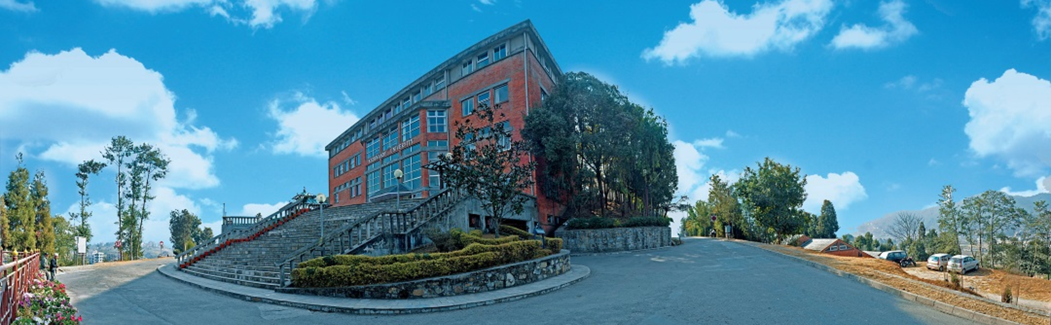
COMPUTER
&
MECHANICAL ENGINEERING
General Physics II
Ganesh Kuwar Chhetri
Dept. of Physics
School of Science
Kathmandu University
1

Slide 2
Course Outline
Differential Calculus
Ordinary” Derivatives
The Operator
Gradient
The Divergence
The Curl
2

Slide 3
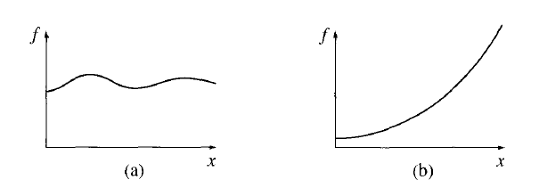
Ordinary Derivatives
Suppose we have a function of one variable .
The derivative tells us how rapidly the function varies when
we change the argument by a tiny amount, :
Geometrical Interpretation: The derivative is the slope of the graph of versus .
Figure De-1
3

Slide 4
The Operator
The vector differential operator del (nabla), defined in Cartesian coordinates as
It is without specific meaning until we provide it with a function to act upon.
There are three ways the operator can act:
1. On a scalar function T :
2. On a vector function :
3. On a vector function :
4

Slide 5
Gradient
Suppose that we have a function of three variables say, the temperature in a room .
A theorem on partial derivatives states that
From Equation (G-1):
Geometrical Interpretation:
The gradient points in the direction of maximum increase of the function T .
5

Slide 6
Example 1
Suppose that the temperature T at the point is given by the equation . In which direction is the temperature increasing most rapidly at and at what rate?
6

Slide 7
Example 2
Gravitational Potential Energy
Gravitational Potential Energy near the earth is given by
The maximum change in gravitational potential energy is vertically upwards the centre of Earth.
7

Slide 8
Gradient of a Scalar Field
Gradient of a Scalar Field T is
Grad turns a scalar field into a vector field.
The gradient points in the direction of maximum increase of T .
is the rate of maximum increase.
8

Slide 9
Problems
(1) Find the gradient of the function:
Solution:
(2) Find the gradient of the function .
Ans:
(3) The gradient of the function at the point is
……………..
Ans:
9

Slide 10
Problems
(1) The magnitude of the position vector is .
(a) Find .
10

Slide 11
Problems
Hints:
11

Slide 12
The Divergence
The divergence of a vector , written or , is defined as follows:
The divergence of a vector is the limit of its surface integral per unit volume as the volume enclosed by the surface goes to zero. That is,
The divergence is clearly a scalar point function (scalar field), and it is defined at the limit point of the surface of integration.
12

Slide 13
The Divergence
The divergence of a vector function :
Geometrical Interpretation:
The divergence of a vector function , is a measure of how much the vector spreads out (diverges) from the point in question.
Imagine standing at the edge of a pond. Sprinkle some sawdust or pine needles on the surface. If the material spreads out, then you dropped it at a point of positive divergence; if it collects together, you dropped it at a point of negative divergence. (The vector function in this model is the velocity of water.)
13

Slide 14
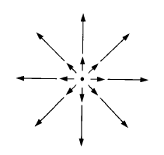
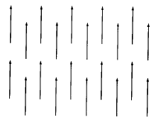
The Divergence
The vector function in Figure D-1 has a large positive divergence.
Figure D-1
A point of positive divergence is a source, or “faucet”; a point of negative divergence is a sink, or “drain”.
The vector function in Figure D-2 has zero divergence.
Figure D-2
14

Slide 15
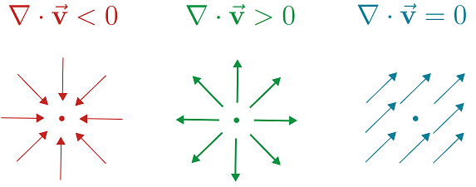
Interpretation of Divergence
15

Slide 16
Problems
Calculate the divergence of vector function
Solution:
If find at .
Solution:
16

Slide 17
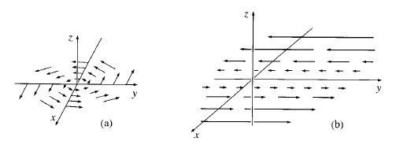
The Curl
The component of in the direction of the unit vector is the limit of a line integral per unit area, as the enclosed area goes to zero, this area being perpendicular to . That is,
where the curve , which bounds the surface , is in a plane normal to .
The vector function in Figure C-1 has a substantial curl, pointing in the z-direction, as the natural right-hand rule would suggest.
Figure C-1
17

Slide 18
The Curl
The curl of a vector function :
Geometrical Interpretation:
The curl of a vector function , is a measure of how much the vector “curls around” the point in question.
If , then is irrotational.
18

Slide 19
Problems
Calculate the curl of vector function
Solution:
19

Slide 20
Problem
If
Solution:
20

Slide 21
Text Books & References
David J. Griffith, Introduction to Electrodynamics
R. A. Serway and J.W. Jewett, Physics for Scientist and Engineers with Modern Physics
Halliday and Resnick, Fundamental of Physics
21

Slide 22

22

